Slide 1
File-System Interface

Slide 2
Outline
File Concept
Access Methods
Disk and Directory Structure
Protection
Memory-Mapped Files

Slide 3
Objectives
To explain the function of file systems
To describe the interfaces to file systems
To discuss file-system design tradeoffs, including access methods, file sharing, file locking, and directory structures
To explore file-system protection

Slide 4
File Concept
A file is a named collection of related information that is recorded on secondary storage
Files may contain programs (source, object) and data (alphabetic, alphanumeric,or binary
Contents defined by file’s creator –source or executable programs, numeric or text data, photos, music, video,
Files may be free form, such as text files, or may be formatted rigidly.
In general, a file is a sequence of bits, bytes, lines, or records, the meaning of which is defined by the file’s creator and user

Slide 5
File Concept
Afile has a certain defined structure, which depends on its type.
A text file is a sequence of characters organized into lines (and possibly pages).
A source file is a sequence of functions, each of which is further organized as declarations followed by executable statements.
An executable file is a series of code sections that the loader can bring into memory and execute.

Slide 6
File Attributes
Name – only information kept in human-readable form
Identifier – unique tag (number) identifies file within file system
Type – needed for systems that support different types
Location – pointer to file location on device
Size – current file size
Protection – controls who can do reading, writing, executing
Time, date, and user identification – data for protection, security, and usage monitoring
Information about files are kept in the directory structure, which is maintained on the disk
Many variations, including extended file attributes such as file checksum
Information kept in the directory structure

Slide 7
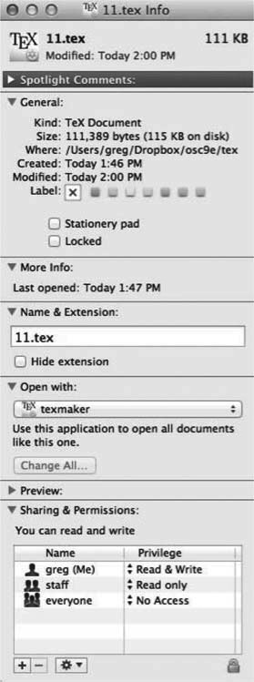
File info Window on Mac OS X

Slide 8
Directory Structure
A collection of nodes containing information about all files
Both the directory structure and the files reside on disk

Slide 9
File Operations
Creating a file - . Two steps are necessary to create a file. First, space in the file system must be found for the. Second, an entry for the new file must be made in a directory.
Opening a file - Rather than have all file operations specify a file name, causing the operating system to evaluate the name, check access permissions, and so on, all operations except create and delete require a open() first. If successful, the open call returns a file handle that is used as an argument in the other calls.

Slide 10
File Operations
Writing a file . To write a file, we make a system call specifying both the open file handle and the information to be written to the file.
  The system must keep a write pointer to the location in the file where the next write is to take place if it is sequential. The write pointer must be updated whenever a write occurs.
Reading a file . To read from a file, we use a system call that specifies the file handle and where (in memory) the next block of the file should be put. Again, the system needs to keep a read pointer to the location in the file where the next read is to take place, if sequential. Once the read has taken place, the read pointer is updated.
Because a process is usually either reading from or writing to a file, the current operation location can be kept as a per-process current-file-position pointer. Both the read and write operations use this same pointer, saving space and reducing system complexity.

Slide 11
File Operations
Because a process is usually either reading from or writing to a file, the current operation location can be kept as a per-process current-file-position pointer.
Both the read and write operations use this same pointer, saving space and reducing system complexity.

Slide 12
File Operations
Repositioning within a file. The current-file-position pointer of the open file is repositioned to a given value. Repositioning within a file need not involve any actual I/O. This file operation is also known as a file seek.
Deleting a file . To delete a file, we search the directory for the named file. Having found the associated directory entry, we release all file space, so that it can be reused by other files, and erase or mark as free the directory entry. Note that some systems allow hard links—multiple names (directory entries) for the same file. In this case the actual file contents is not deleted until the last link is deleted.
• Truncating a fil . The user may want to erase the contents of a file but
keep its attributes. Rather than forcing the user to delete the file and then
recreate it, this function allows all attributes to remain unchanged—except
for file length. The file can then be reset to length zero, and its file space
can be released.

Slide 13
File Operations
Truncating a file . The user may want to erase the contents of a file but keep its attributes.
Rather than forcing the user to delete the file and then recreate it, this function allows all attributes to remain unchanged—except for file length.
The file can then be reset to length zero, and its file space can be released.
These are the 7 basic operations on a file..other operations copy, move etc

Slide 14
Open Files
Several pieces of data are needed to manage open files:
Per process open file table – process specific information – current file position pointer, access permission, accounting information etc
System wide open file table – process independent information
  File-open count: counter of number of times a file is open – to allow removal of data from open-file table when last processes closes it
  Disk location of the file: cache of data access information
  Access rights: per-process access mode information. Access Date, File Size

Slide 15
File Locking
Provided by some operating systems and file systems
  Similar to reader-writer locks
  Shared lock similar to reader lock – several processes can acquire concurrently
  Exclusive lock similar to writer lock
Mediates access to a file
Mandatory or advisory:
  Mandatory – access is denied depending on locks held and requested
  Advisory – processes can find status of locks and decide what to do

Slide 16
File Locking Example – Java API
import java.io.*;
import java.nio.channels.*;
public class LockingExample {
public static final boolean EXCLUSIVE = false;
public static final boolean SHARED = true;
public static void main(String arsg[]) throws IOException {
FileLock sharedLock = null;
FileLock exclusiveLock = null;
try {
RandomAccessFile raf = new RandomAccessFile("file.txt", "rw");
// get the channel for the file
FileChannel ch = raf.getChannel();
// this locks the first half of the file - exclusive
exclusiveLock = ch.lock(0, raf.length()/2, EXCLUSIVE);
/** Now modify the data . . . */
// release the lock
exclusiveLock.release();

Slide 17
File Locking Example – Java API (Cont.)
// this locks the second half of the file - shared
sharedLock = ch.lock(raf.length()/2+1, raf.length(), SHARED);
/** Now read the data . . . */
// release the lock
sharedLock.release();
} catch (java.io.IOException ioe) {
System.err.println(ioe);
}finally {
if (exclusiveLock != null)
exclusiveLock.release();
if (sharedLock != null)
sharedLock.release();
}
}
}

Slide 18
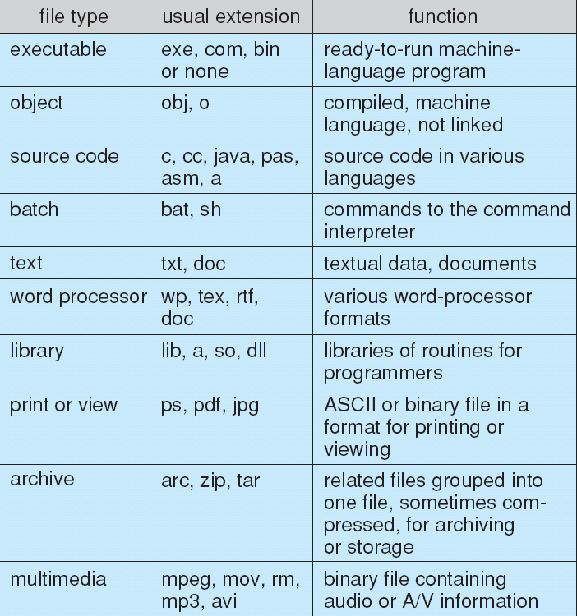
File Types – Name, Extension
Enforced by file name extension (windows), creator attribute (mac), magic number (unix)

Slide 19
File Structure
None - sequence of words, bytes
Simple record structure
  Lines
  Fixed length
  Variable length
Complex Structures
  Formatted document
  Relocatable load file
Can simulate last two with first method by inserting appropriate control characters
Who decides:
  Operating system
  Program

Slide 20
Access Methods
A file is fixed length logical records
Sequential Access
Direct Access
Other Access Methods

Slide 21
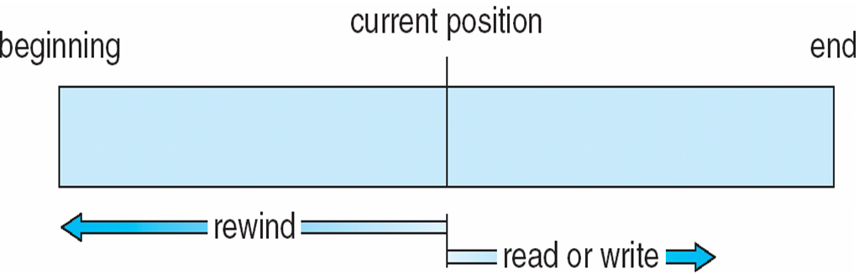
Sequential Access
Operations
  read next
  write next
  Reset
  no read after last write (rewrite)
Figure

Slide 22
Direct Access
Operations
  read n
  write n
  position to n
    read next
    write next
    rewrite n
n = relative block number
Relative block numbers allow OS to decide where file should be placed

Slide 23
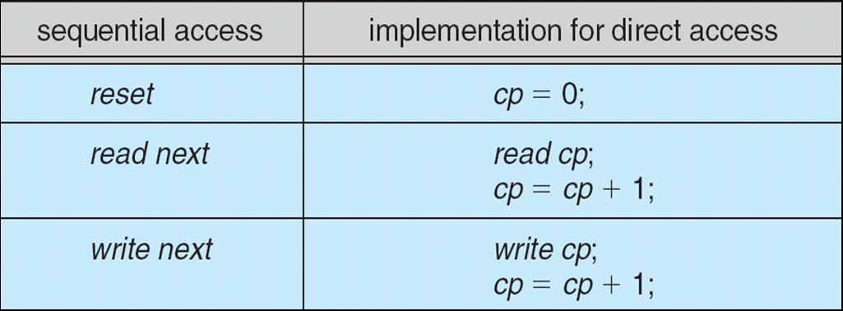
Simulation of Sequential Access on Direct-access File

Slide 24
Other Access Methods
Can be other access methods built on top of base methods
General involve creation of an index for the file
Keep index in memory for fast determination of location of data to be operated on (consider Universal Produce Code (UPC code) plus record of data about that item)
If the index is too large, create an in-memory index, which an index of a disk index
IBM indexed sequential-access method (ISAM)
  Small master index, points to disk blocks of secondary index
  File kept sorted on a defined key
  All done by the OS
VMS operating system provides index and relative files as another example (see next slide)

Slide 25
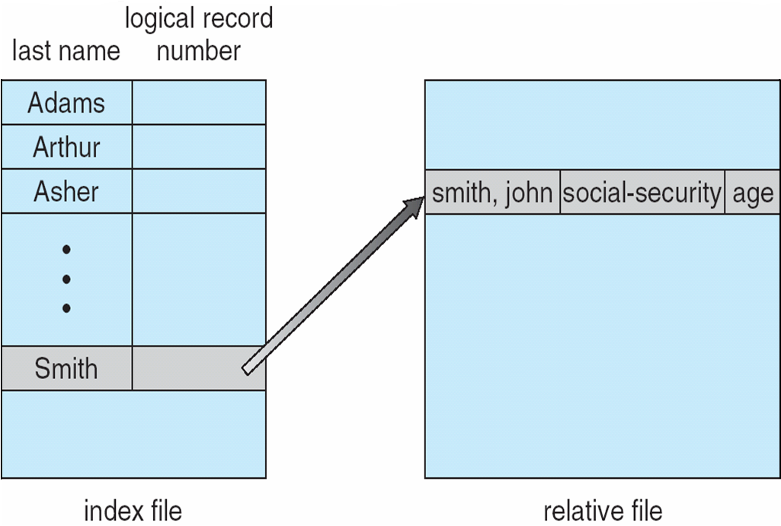
Example of Index and Relative Files

Slide 26
Directory Structure
The directory contains information about files ( location, access permission, owner, size etc.)
  File Control Block (FCB) – info about files is kept
Directory may contain FCB no
Unix – FCB is called inode

Slide 27
Operations Performed on Directory
Search for a file
Create a file
Delete a file
List a directory
Rename a file
Traverse the file system

Slide 28
Directory Organization
The directory is organized logically to obtain
Efficiency – locating a file quickly
Naming – convenient to users
  Two users can have same name for different files
  The same file can have several different names
Grouping – logical grouping of files by properties, (e.g., all Java programs, all games, …)

Slide 29
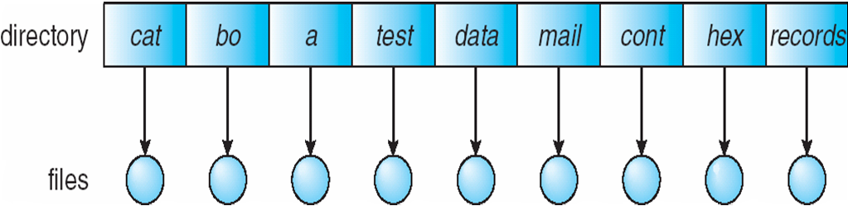
Single-Level Directory
A single directory for all users
Naming problem
Grouping problem

Slide 30
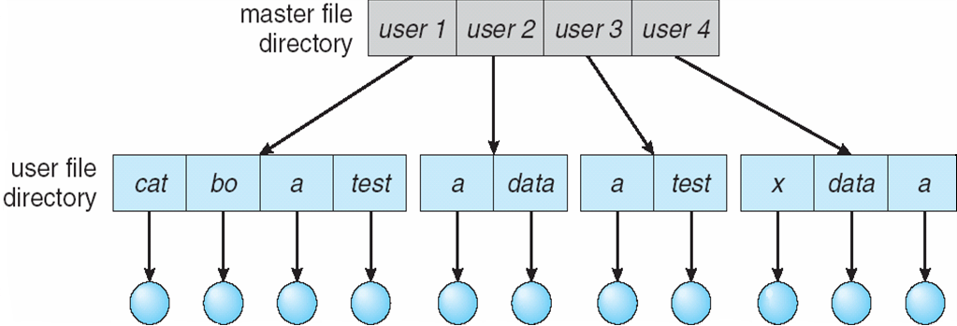
Two-Level Directory
Separate directory for each user
Path name
Can have the same file name for different user
Efficient searching
No grouping capability

Slide 31
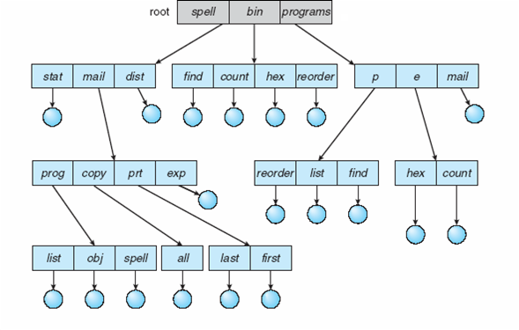
Tree-Structured Directories

Slide 32
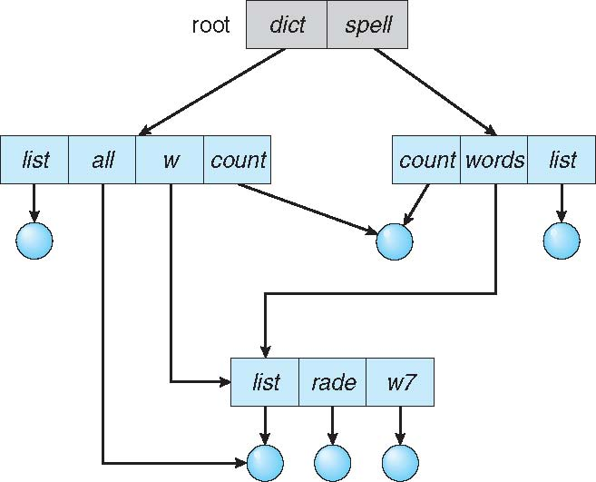
Acyclic-Graph Directories
Have shared subdirectories and files
Example

Slide 33
Acyclic-Graph Directories (Cont.)
Two different names (aliasing)
If dict deletes w/list ⇒ dangling pointer
Solutions:
  Backpointers, so we can delete all pointers.
    Variable size records a problem
  Backpointers using a daisy chain organization
  Entry-hold-count solution
New directory entry type
  Link – another name (pointer) to an existing file
  Resolve the link – follow pointer to locate the file

Slide 34
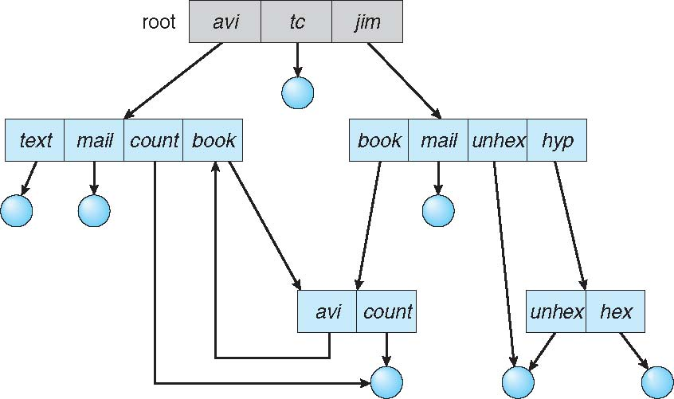
General Graph Directory

Slide 35
General Graph Directory (Cont.)
How do we guarantee no cycles?
  Allow only links to files not subdirectories
  Garbage collection
  Every time a new link is added use a cycle detection algorithm to determine whether it is OK

Slide 36
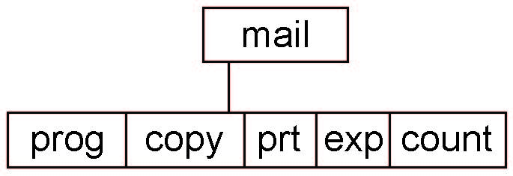
Current Directory
Can designate one of the directories as the current (working) directory
  cd /spell/mail/prog
  type list
Creating and deleting a file is done in current directory
Example of creating a new file
  If in current directory is /mail
  The command
mkdir <dir-name>
  Results in:
  Deleting “mail” ⇒ deleting the entire subtree rooted by “mail”

Slide 37
Protection
File owner/creator should be able to control:
  What can be done
  By whom
Types of access
  Read
  Write
  Execute
  Append
  Delete
  List

Slide 38
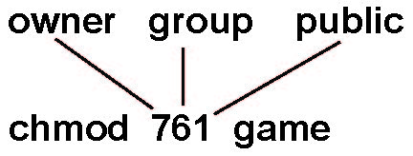
Access Lists and Groups in Unix
Mode of access: read, write, execute
Three classes of users on Unix / Linux
RWX
a) owner access 7 ⇒ 1 1 1
RWX
b) group access 6 ⇒ 1 1 0
RWX
c) public access 1 ⇒ 0 0 1
Ask manager to create a group (unique name), say G, and add some users to the group.
For a file (say game) or subdirectory, define an appropriate access.
Attach a group to a file
chgrp G game

Slide 39
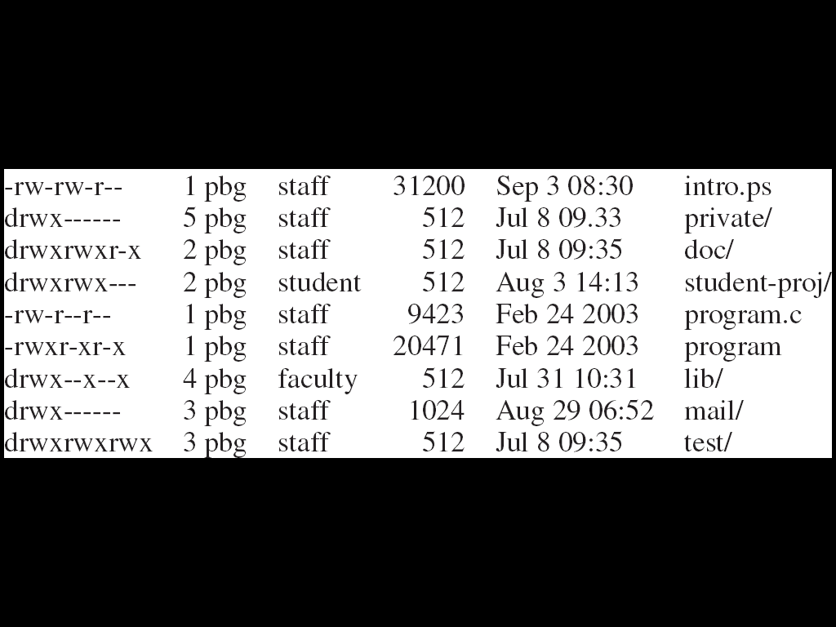
A Sample UNIX Directory Listing

Slide 40
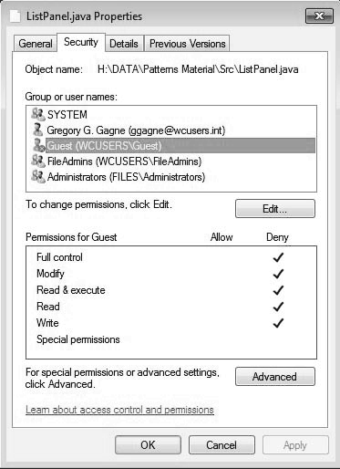
Windows 7 Access-Control List Management

Slide 41
Disk Structure
Disk can be subdivided into partitions
Disks or partitions can be RAID protected against failure
Disk or partition can be used raw – without a file system, or formatted with a file system
Partitions also known as minidisks, slices
Entity containing file system is known as a volume
Each volume containing a file system also tracks that file system’s info in device directory or volume table of contents
In addition to general-purpose file systems there are many special-purpose file systems, frequently all within the same operating system or computer

Slide 42
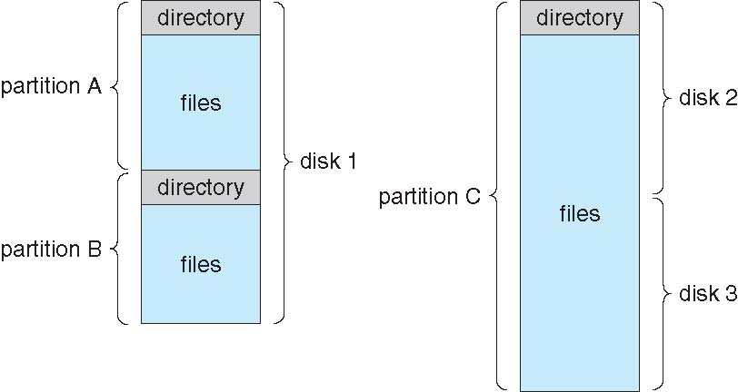
A Typical File-system Organization

Slide 43
Types of File Systems
We mostly talk of general-purpose file systems
But systems frequently have may file systems, some general- and some special- purpose
Consider Solaris has
  tmpfs – memory-based volatile FS for fast, temporary I/O
  objfs – interface into kernel memory to get kernel symbols for debugging
  ctfs – contract file system for managing daemons
  lofs – loopback file system allows one FS to be accessed in place of another
  procfs – kernel interface to process structures
  ufs, zfs – general purpose file systems

Slide 44
End

